Slide 1
Distributed Computing Project Happy Hospitals
Ajay Pal Singh
Vu Le
Vishrut Sharma

Slide 2
Components
RESTful web service
Cassandra database
Hazelcast
Messaging with Active MQ
Apache Camel
Java SPRING

Slide 3
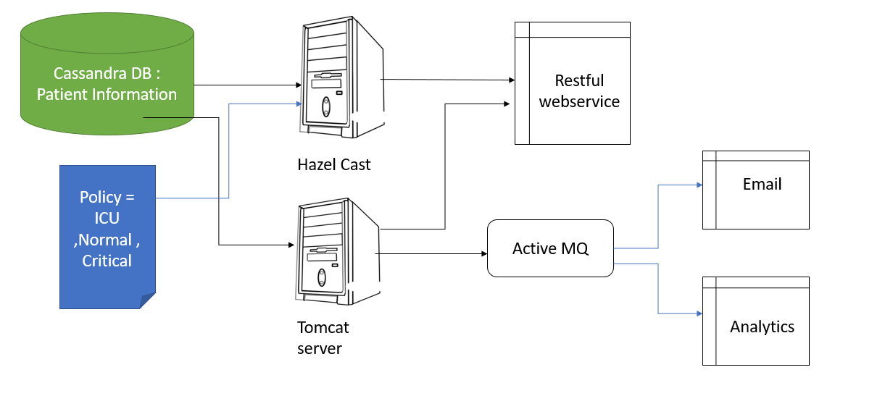
Architecture

Slide 4

What we already knew…..
Java Programming
Tomcat server
Maven…

Slide 5

Created sample rest APIs using spring to see how spring works
Tried hand at jersey but decided to drop implementing in jersey
Performed multiple tests of dummy Cassandra databases
Tried running REST API with embedded tomcat server
Initially tried saving data into an array list and creating JSON objects from array list performing GET/POST etc.

Slide 6
Environment Setup
Multiple downloads :
Apache tomcat – 7.082
Datastax for Cassandra 3.0 / 2.0
Active MQ
Apache Camel – 2.19.1
Spring / SpringBoot : Spring initializr
Hazelcast 3.6x

Slide 7
What we had to learn from scratch?
Setting up the environment
Using SPRING to create a restful webservice
How data is stored inside a Cassandra cluster
Structure of a Cassandra table (keyspace)
Active MQ
Connecting Cassandra with RESTful webservice
Integrating different components – Apache Camel

Slide 8
Links :
Official tutorials from Datastax : Cassandra
https://www.tutorialspoint.com/cassandra/
http://www.baeldung.com/spring-data-cassandra-tutorial
https://examples.javacodegeeks.com/enterprise-java/spring/spring-data-cassandra-example/
Hazelcast : Multiple sources online:
https://hazelcast.org/getting-started-with-hazelcast/
http://docs.hazelcast.org/docs/3.0/manual/html/ch01s03.html
http://www.baeldung.com/java-hazelcast
https://www.javacodegeeks.com/2013/11/getting-started-with-hazelcast.html
http://www.javainuse.com/hazelcast

Slide 9
Links
REST API with spring : course on udemy
https://www.udemy.com/spring-web-services-tutorial/learn/v4/overview
Active MQ :
http://www.mastertheintegration.com/core-apache-projects/activemq/introduction-to-activemq/activemq-lesson-1-getting-started-with-activemq.html
https://www.codenotfound.com/spring-jms-activemq-consumer-producer-example.html
http://shengwangi.blogspot.com/2014/10/spring-jms-with-activemq-helloworld-example-send.html
Apache Camel:
http://camel.apache.org/tutorial-example-reportincident-part1.html
AND MANY MORE…..

Slide 10

Problems faced
Finding correct configuration parameters to connect and authenticate with Gmail server for sending email
Operating system issues : Windows / Linux
Multiple compatibility issues between Cassandra 3.0 and spring data Cassandra
Ultimately tried with older version of Cassandra and worked
Sending messages to ActiveMQ from different IP addresses (machines)
Initialization of beans in java using multiple initialization methods
Dependency issues faced when running RESTful webservice
Issues faced during parsing content from Cassandra DB in correct format

Slide 11

ActiveMQ – Messaging software
Allows applications built with different languages and on different operating systems to integrate with each other.
Client applications don’t need to know where the service applications are located.
Can scale horizontally by adding more services that can handle the messages if too many messages are arriving.
A client can fire a message and continue other processing instead of blocking until the service has sent a response.
A service can change details about itself, including its location, protocol, and availability, without affecting or disrupting the client(Reduced Coupling)

Slide 12
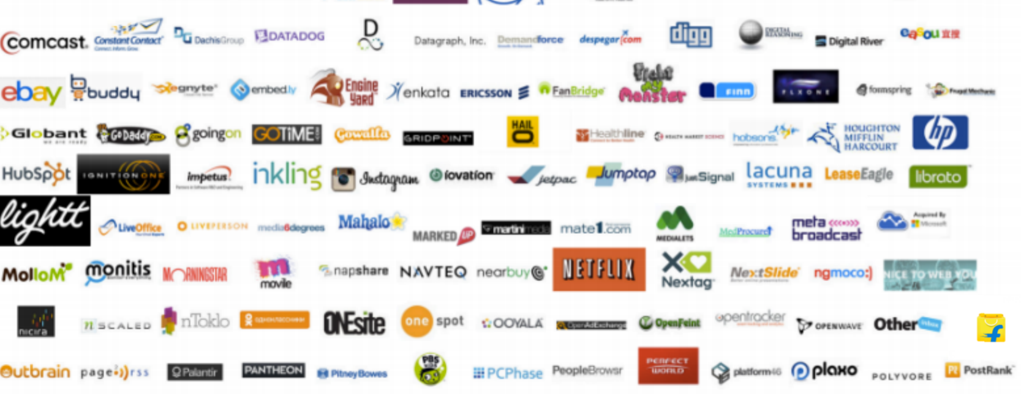
Cassandra DB
Keywords : Distributed ,High Performance, Extremely Scalable, Fault Tolerant, Column Oriented
Has a SQL query like language called CQL
Best use case : Petabytes of data ,data is columnar , Real time very fast lookups
Introduced first as Facebook inbox feature

Slide 13
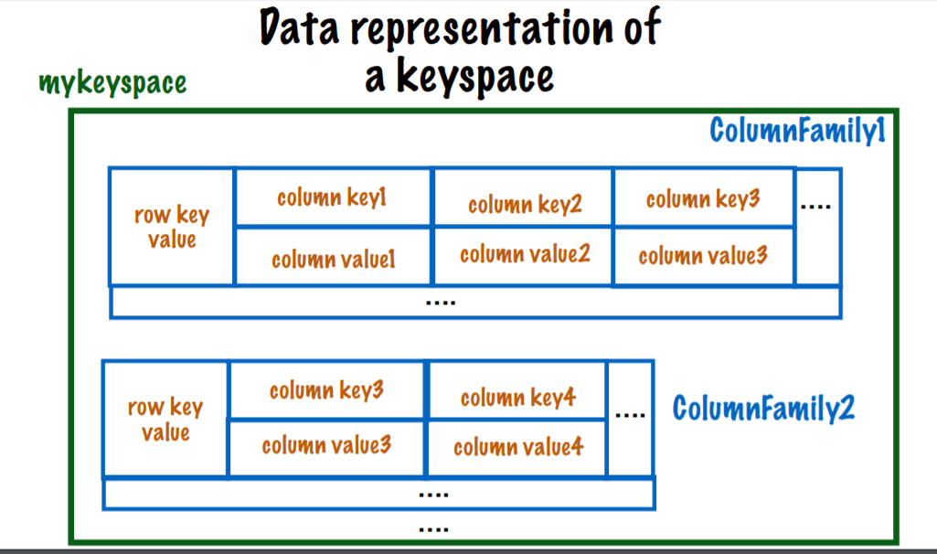
Relational DB and Cassandra
Relational | Cassandra
Database | keyspace
Table | Columnfamily
Primary key | Row key
Column name | Column name
Column Value | Column Value

Slide 14
Apache Camel –Integration framework
Concise Application Messaging Exchange Language
Why integration framework ?
Use it to do the heavy lifting between components
Focus on code instead of connectivity
Not reinvent the wheel
Offeres interfaces for components to communicate via messages
Used as a middleman to
Consume data from any source/format
Perform some processing
Output data to any source / format

Slide 15
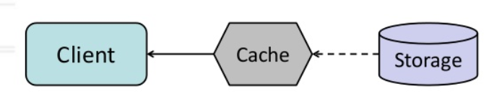
Hazelcast
Application can have many concurrent users
Reduce the time and cost overhead to access data from database
Database access bottlenecks can occur due to too many simultaneous requests.
With Hazelcast:
Improve response time by reducing access latency
Offload persistent storage by reducing trips to the data source
Avoid cost of repeatedly creating objects

Slide 16
Hazelcast
For the happy hospitals :
Cache never fetched when data is being updated
Cache updated every 1 min
1st request always used to initialize the cache
Cache only contains data specified in policy
For any request , first check cache then DB
Remove operation deletes data from both cache and DB
Every action performed is sent to AQM
From there directed to mail and analystics engine

Slide 17
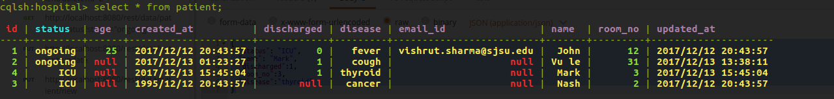
Operations
Initial database structure
After insert

Slide 18
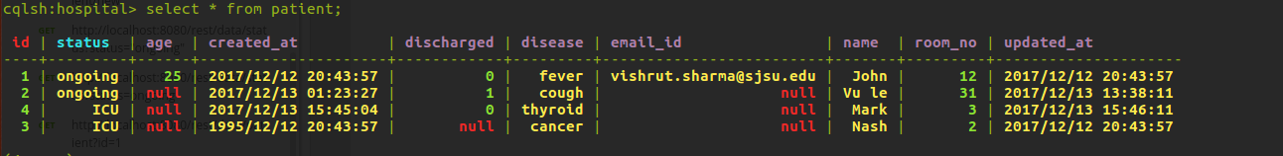
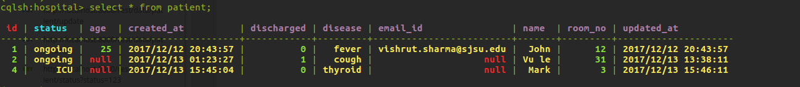
Operations
After Update
After Delete

